Slide 1
Social Media Analytics
Topic 1: Introduction to Social Media

Slide 2
Learning Objectives
History of social media
What is social media?
The characteristics of social media

Slide 3
Understanding the basics of Social Media

Slide 4

History of Social Media

Slide 5

What is Social Media?
Social Media combines a wide range of online, word-of-mouth forums including blogs, company sponsored discussion boards and chat rooms, consumer-to-consumer e-mail, consumer product or service ratings websites and forums, internet discussion boards and forums, and micro-blogs (Wikipedia)

Slide 6
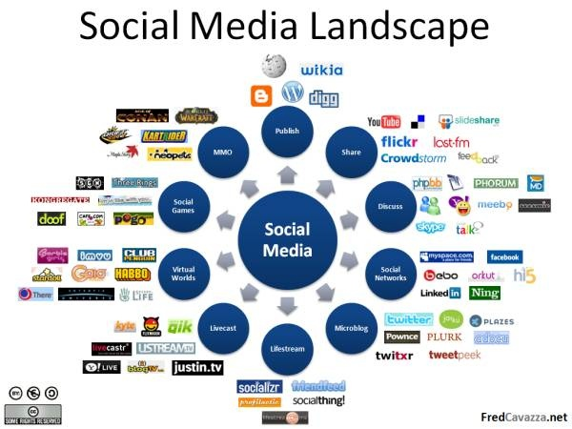
What is Social Media?

Slide 7

The Characteristics of Social Media

Slide 8
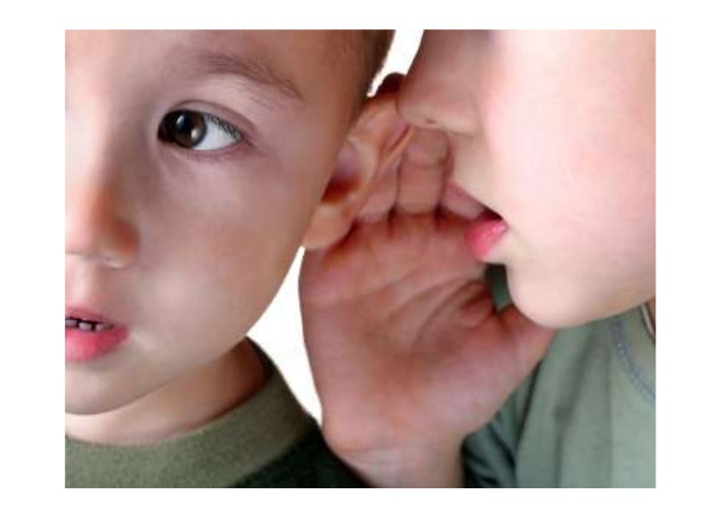
The Characteristics of Social Media
Conversations and Dialogue

Slide 9
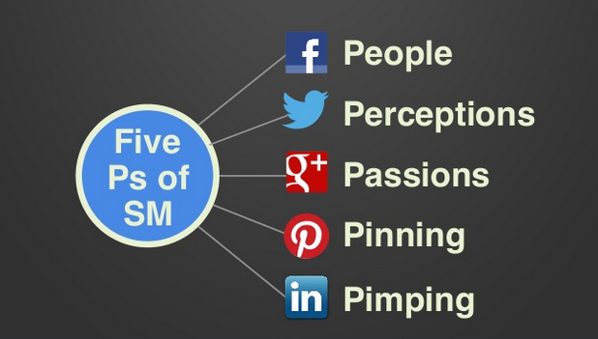
The Characteristics of Social Media
5 Segment of Services
Source: Guy Kawasaki

Slide 10
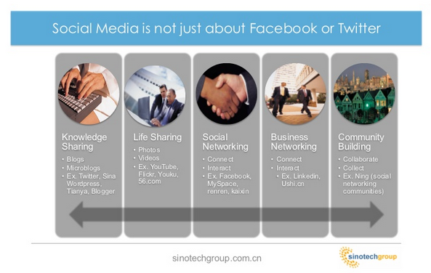
The characteristics of social media

